Slide 1
A byte about Intune, PowerShell & Graph API
Ralph Eckhard

Slide 2


Ralph Eckhard
Cloud Architect @ PeopleWare ICT
https://www.365dude.nl
https://twitter.com/ralpje

Slide 3
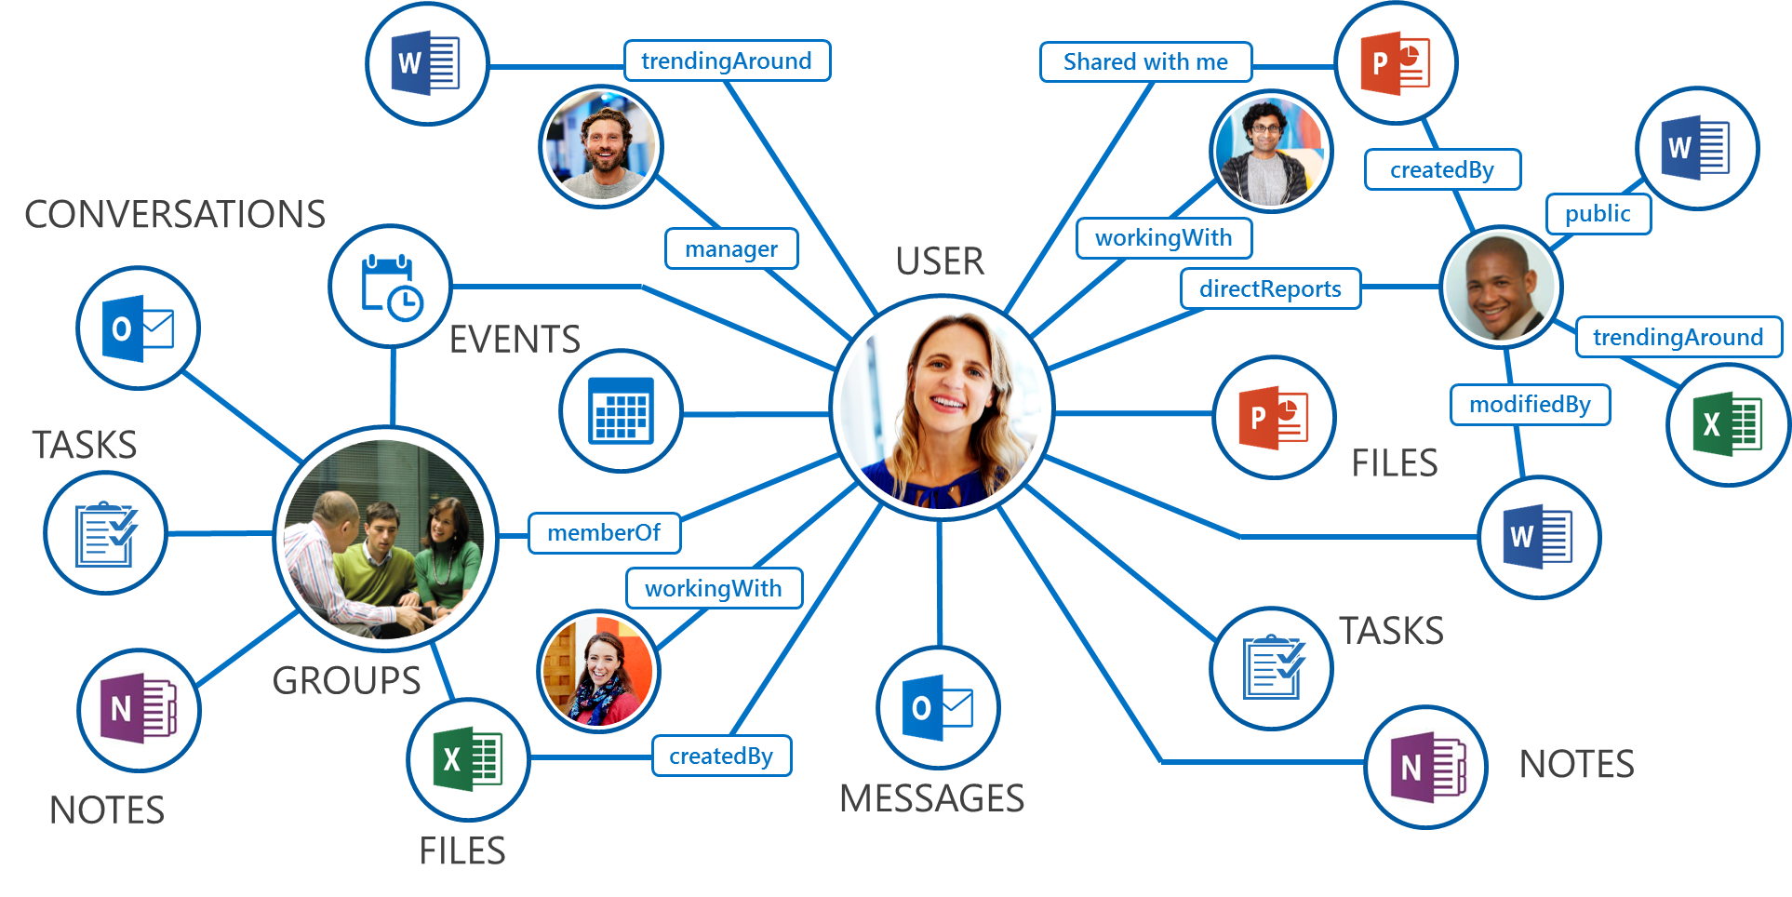


Slide 4
Connecting to the Graph API
REST-calls via Invoke-RestMethod
Authentication through token in the header
Registered App in AzureAD for access rights
Authentcation examples to be found on GitHub:
https://github.com/microsoftgraph/powershell-intune-samples

Slide 5
Connecting to the Graph API
GET, POST, PATCH, etc.
Documentation: https://developer.microsoft.com/en-us/graph/docs/concepts/overview
Graph Explorer: https://developer.microsoft.com/en-us/graph/graph-explorer
In- and Output based on JSON

Slide 6
}
}
URL
RESOURCE
https://graph.microsoft.com/beta/users
}
VERSION

Slide 7
}
}
URL
RESOURCE
https://graph.microsoft.com/beta/drives
}
VERSION

Slide 8
}
}
URL
RESOURCE
https://graph.microsoft.com/beta/groups
}
VERSION

Slide 9


Slide 10
Learn more?
Code and presentation online today at www.365dude.nl
Microsoft provided resources on GitHub
Just do it!

Slide 11
Let me learn more?
Review my session using the Yellenge app
Leave a comment on www.365dude.nl
Hit me up on twitter
@ralpje

Slide 12
Next session: 11:30 – 12:30
Unified labelling in Office 365 - does it fulfill its promises?
Albert Hoitingh

